Slide 1
Final Project: Wine Data Unsupervised Learning
Pavlenko A.

Slide 2
Goal:
Provide an Unsupervised Learning problem resolution to Wine Data set to perform EDA and model analysis.
Methods:
The clustering performed with k-means approach
Dimension Reduction by using PCA.

Slide 3
Table of Contents:
1. EDA - Exploratory Data Analysis
2. Normalizing Data
3. Evaluating Clustering Algorithm
4. k-Means Clustering
5. Dimensionality Reduction Using Principal Component Analysis (PCA)
6. After Dimensionality Reduction
7. Clustering After Reducing Dimensions
8. Summary / Conclusion

Slide 4
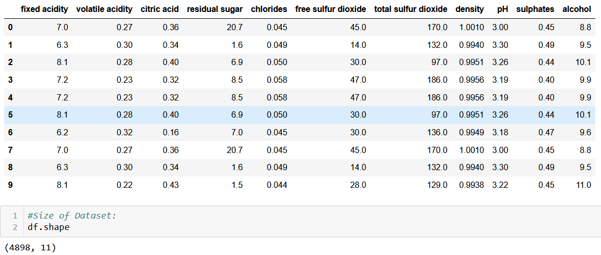
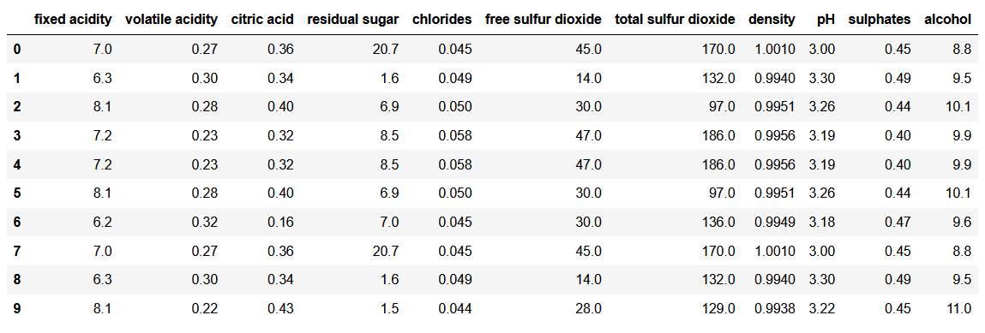
Data:

Slide 5
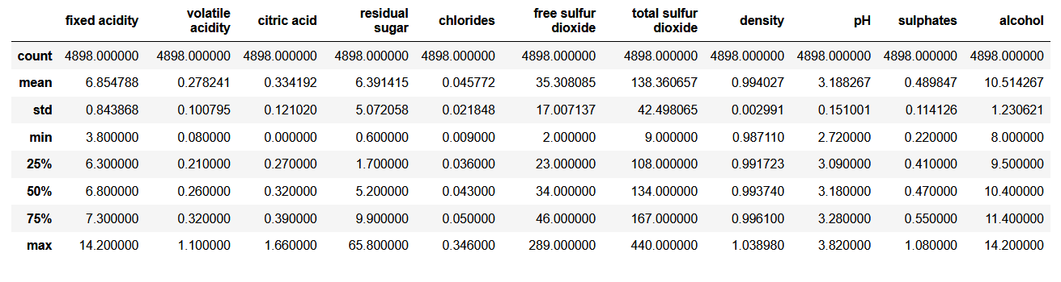
General Statistic:

Slide 6
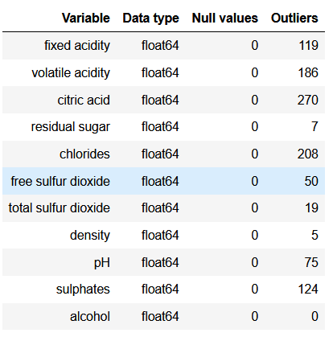
EDA - Exploratory Data Analysis:

Slide 7
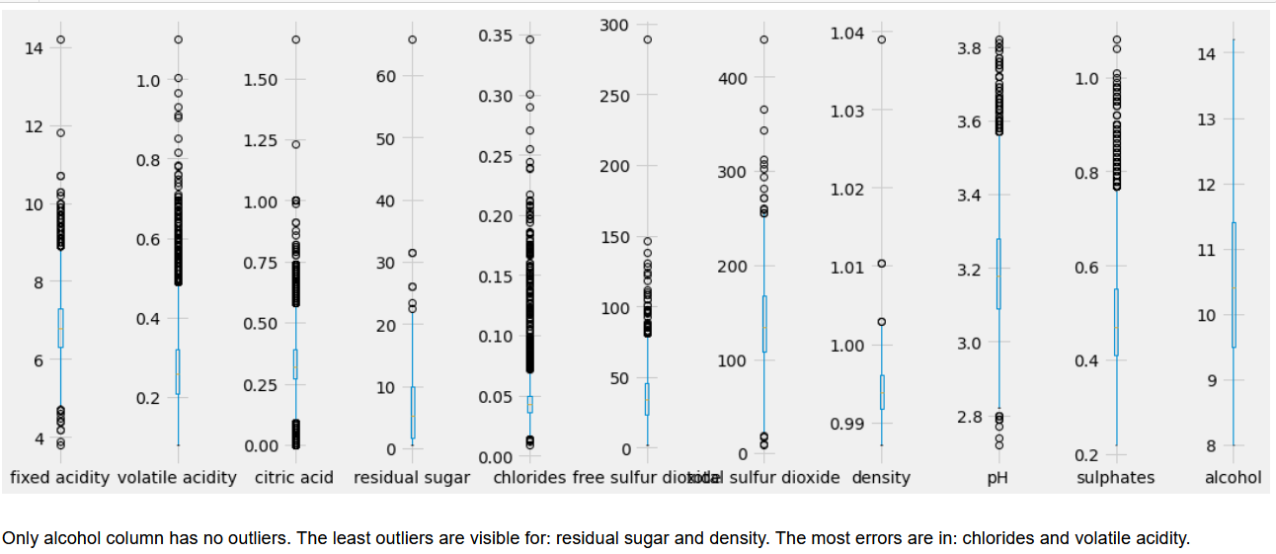
plot_box_plots()

Slide 8
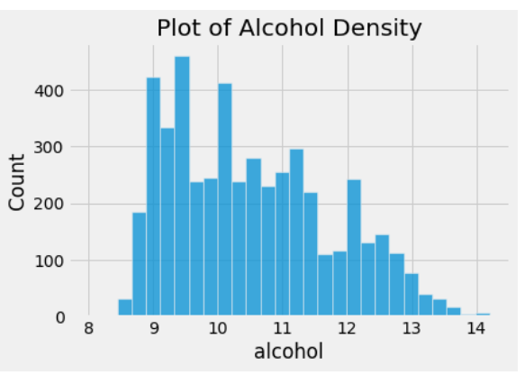

Slide 9
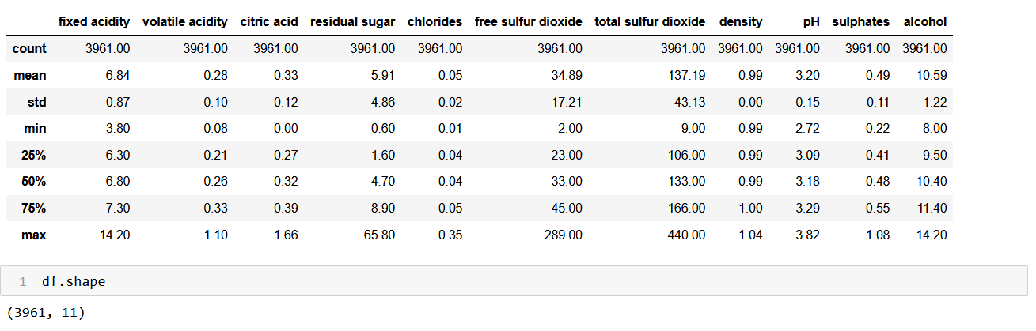
Removing duplicate rows

Slide 10
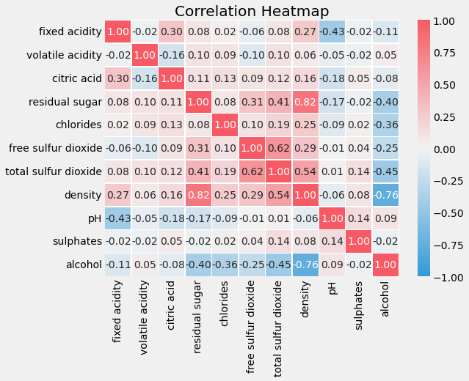
There are some strong, interesting co-dependencies between some of the features:
alcohol vs. density;
total sulfur dioxide (TSO2) vs. free sulfur dioxide (FSO2);
density vs. residual sugar.

Slide 11
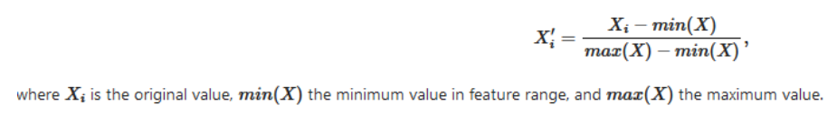
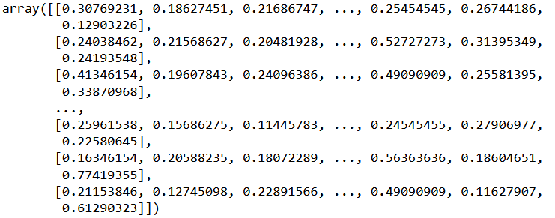
2. Normalizing Data:

Slide 12
3. Evaluating Clustering Algorithm:
Visually
With Measures

Slide 13
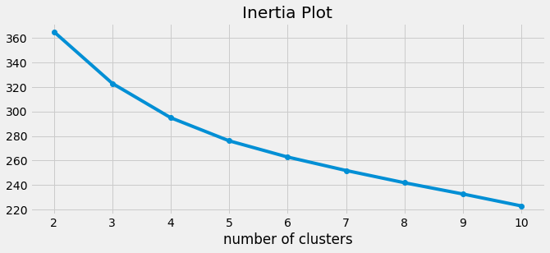
4. k-Means Clustering:

Slide 14
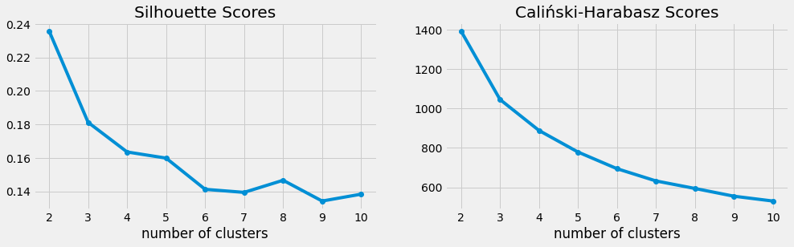

Slide 15
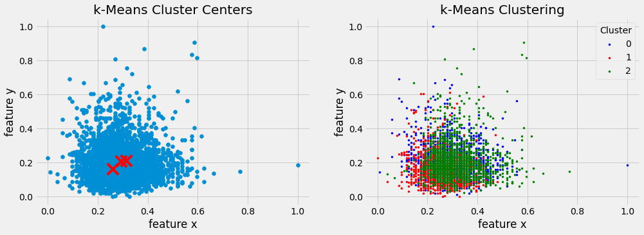

Slide 16
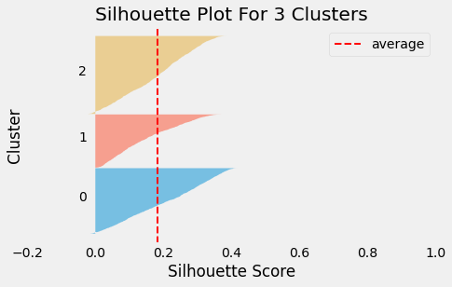
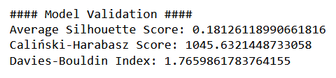

Slide 17
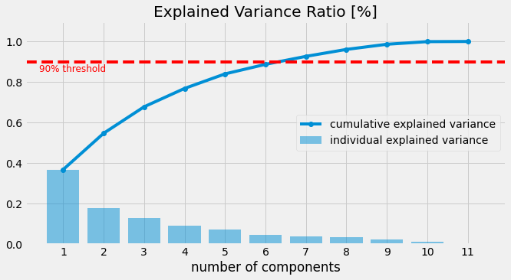
5. Dimensionality Reduction Using Principal Component Analysis (PCA)

Slide 18
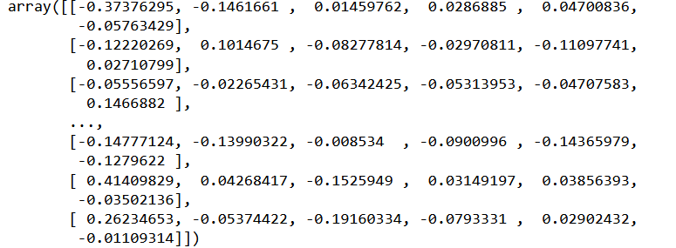
6. After Dimensionality Reduction

Slide 19
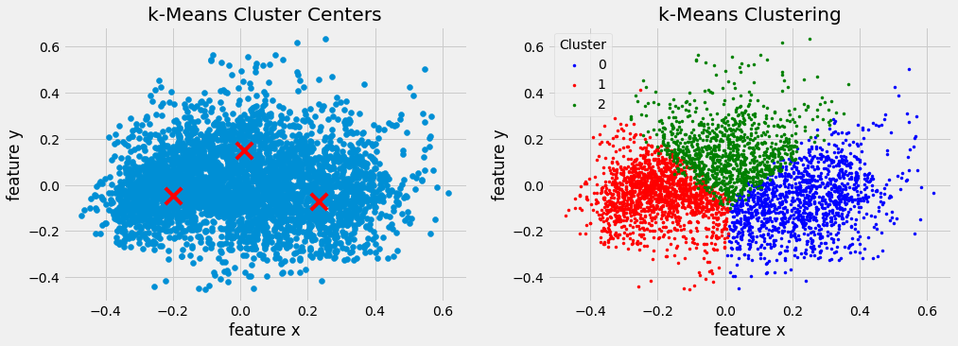
7. Clustering After Dimensionality Reduction

Slide 20
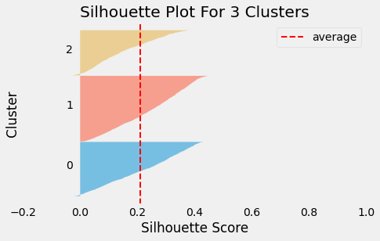
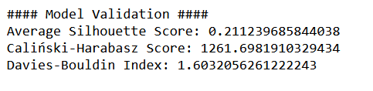

Slide 21
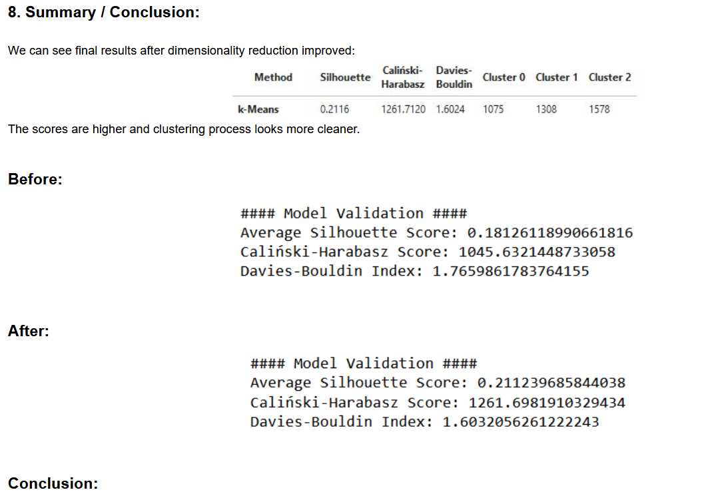

Slide 22
Conclusion:
This project introduces the k-means and PCA unsupervised algorithms that can be applied for exploratory data analysis and preprocessing on white wine dataset.
Right representation of data is crucial for Unsupervised Learning. Important parts of this are Preprocessing and Decomposition methods.
The dimensionality reduction of initial dataset is an essential tool to make sense of the data in the absence of supervision information. Applying PCA method improved the clustering
process. Any further enhancing should be in removing possible outliers in the dataset. Overall, clustering can be a useful exploration tool for identifying
homogeneous groups and pattern recognition within the data. This approach could help us understand more about the data before performing supervised tasks and
develop more refine models.

Slide 23
Thank you!!!

